Slide 1

Enhancing Healthcare: Exploring the Role of Physician Assistants in British Columbia
Patrick Nelson, Executive Director
Lisa Stewart, Director, BC

Slide 2


PA Regulation
Regulated in Alberta, Manitoba, New Brunswick, Saskatchewan, Prince Edward Island and Nova Scotia.
  Ontario to enact regulation this year
Newfoundland and Labrador invested in PA pilot.
Quebec approved Pilot Project in region 18 for Cree Board of Health and Social Services in James Bay.
Yukon government unanimously approved motion for PAs to practice.
British Columbia announces PAs in EDs & CPSBC drafts bylaw amendments to regulate PAs.

Slide 3





Education
Currently four university level academic programs in Canada since 2008:
Programs are highly competitive, over 2500 applicants per year for a combined total of 93 seats.
Masters Programs in development: Exploring:
- University of Calgary - University of Ottawa, Western, Queens
- University of Saskatchewan - University of Laval
Intensive PA Program:
  PA education aligned with medical model to lay foundation for collaborative working relationship with physicians.
    Canadian PA programs are Accreditation Canada EQual accredited.
    Extends over 24 months.
    Combination of didactic training and 48 weeks (over 2,000 hours) of Physician-directed rotations.
    Objective Structured Clinical Exam (OSCE) administered by PA program to assess student's clinical skills and knowledge.
      Series of stations focusing on different aspect of clinical practice

Slide 4
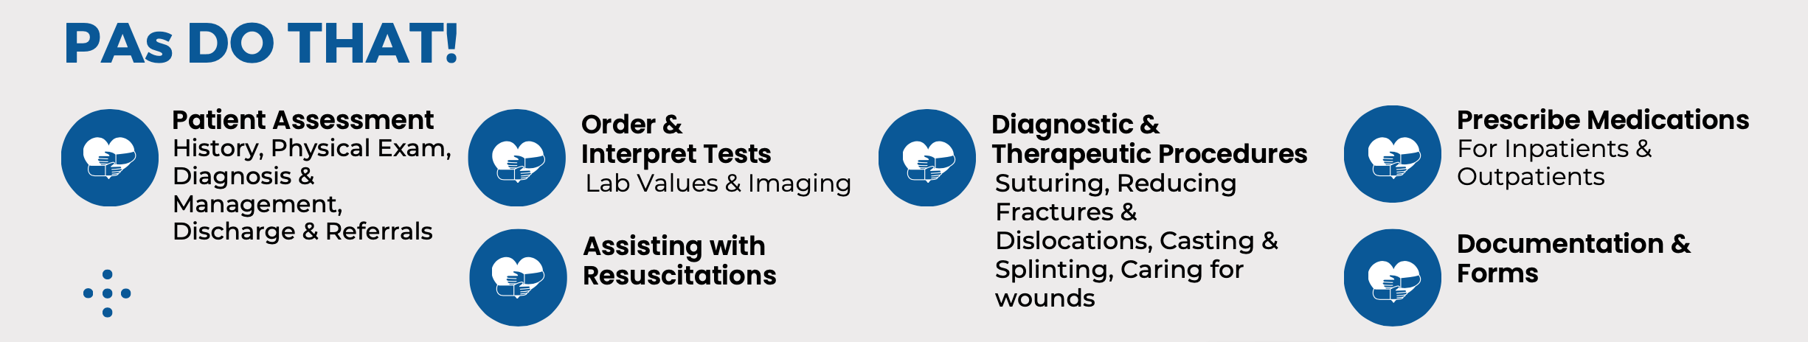
What is a Physician Assistant (PA)?
Advanced health care professional that work as Physician Extenders that can address important challenges in the health care system.​
PAs work under the scope of a supervising physician(s) to provide care to patients.
Negotiated autonomy; Provide care under medical directives, to make decisions and take actions at discretion of supervising physician. ​
Work collaboratively with health professionals in teams to deliver enhanced level of care for patients.

Slide 5

PAs not regulated, “certified non-registrants” of CPSBC.
Island Health recruiting up to 5 PAs for the Saanich Peninsula Hospital Emergency Department.
  Each HA reviewing ED sites, to define regional requirements, and identify priority PA opportunities.
  Each HA will choose one pilot site for now, as their own potential regional PA pilot site, for consideration.
  CPSBC recommends a minimum cohort of 3-4 PAs per site to establish a local community of practice.
  BC Ministry of Health Estimates Debate and PA Advocacy Day both occurred on April 11, 2024:
      The Minister of Health advised that there is active exploration of a PA training program in BC:
      “We have, I think, an obligation, as we're adding physician assistants into our group of our teams of health care professionals starting in emergency departments and certainly elsewhere…. I think we have an obligation not just to take physician assistants from other jurisdictions who are training them but to train them ourselves. So work is being done in the post-secondary sector on that question, as well, as we build out.” - Honorable Adrian Dix, BC Minister of Health, Hansard, April 11, 2024.

Slide 6
Physician / PA Relationship
Supervisory relationship between physician/PA pivotal. Always work within a PA/MD supervisory framework.
Nature of relationship and trust developed is dependent on the physician’s experience with the PA, which grows over time and exposure to the PAs practice.
There is direct and indirect supervision of PAs:
  Direct supervision: physician is physically present during patient encounter.
  Indirect supervision: physician available by phone or electronically to review patient cases and answer PA questions.
  New relationship: Mostly direct supervision to start, transitioning to indirect with more time and experience.
PAs in BC will work under direct on-site supervision of a licensed physician(s).
Each PA and their supervising physician(s) will establish a practice agreement (Contract of Supervision) documenting:
  Clinical work the PA will perform, expectations of the PA, and locations of practice

Slide 7
Certification – National PA License
Canadian Physician Assistant Certification Examination (PACE) to obtain a national license, Canadian Certified Physician Assistant (CCPA).
The Physician Assistant Certification Council of Canada (PACCC) is an independent council of CAPA that administers and maintains the certification process.
  United States national license obtained from National Commission on Certification of Physician Assistants (NCCPA), Physician Assistant – Certified (PA-C)
All PAs must renew Canadian Association of Physician Assistants (CAPA):
    400+ credits in CPD over 5 years and
    40+ credits each year to be able to renew national license
Maintenance of Certification Royal College (MOC) Program Mainport ePortfolio:
    Administered by PACCC.
    Serves as the primary framework for CPD by Canadian Certified Physician Assistants (CCPA).

Slide 8
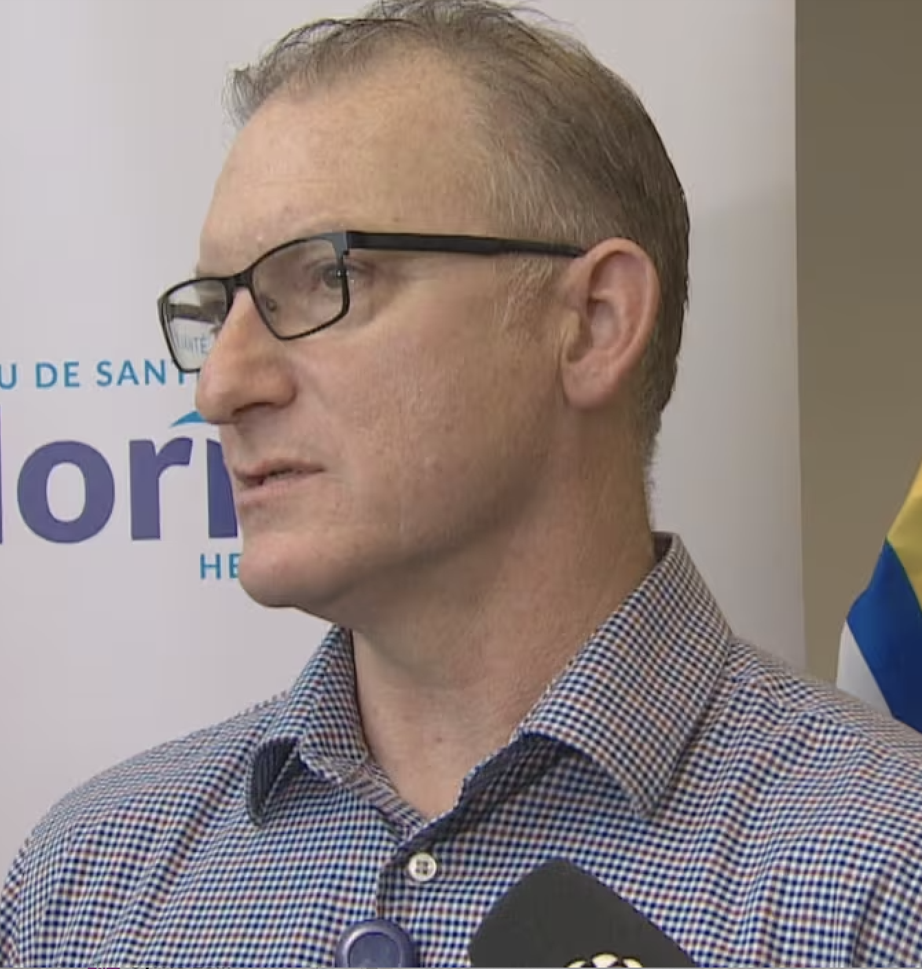





PA / MD Panel
EMERGENCY MEDICINE
PRIMARY CARE
Kevin Dickson, CCPA / Dr. Faye MacKay
Steven Piotrwoski, CCPA / Dr. Grant Goldberg
ORTHOPEDICS
Aurthi Muthukumaran, CCPA / Dr. Warren Latham

Slide 9

BC Physician Panel
Dr. Josh Greggain
Program Director, Post Graduate Family Medicine Program, UBC
Dr. Kevin MacLeod
Internist in Vancouver, and the Yukon
Dr. Aderemi Oyedeji
Chief of Staff, Dawson Creek |Clinical Instructor Dept. Family Practice, UBC

Slide 10



Thank you!
CAPA Executive Director, Patrick Nelson
pnelson@capa-acam.ca
https://capa-acam.ca
CAPA BC Director, Lisa Stewart
lstewart@capa-acam.ca

